Slide 1

ECE 2700
Digital Circuits
Exam II Review
Copyright © 2010 Frank Vahid
Instructors of courses requiring Vahid's Digital Design textbook (published by John Wiley and Sons) have permission to modify and use these slides for customary course-related activities, subject to keeping this copyright notice in place and unmodified. These slides may be posted as unanimated pdf versions on publicly-accessible course websites.. PowerPoint source (or pdf with animations) may not be posted to publicly-accessible websites, but may be posted for students on internal protected sites or distributed directly to students by other electronic means. Instructors may make printouts of the slides available to students for a reasonable photocopying charge, without incurring royalties. Any other use requires explicit permission. Instructors may obtain PowerPoint source or obtain special use permissions from Wiley – see http://www.ddvahid.com for information.

Slide 2
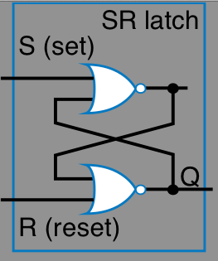
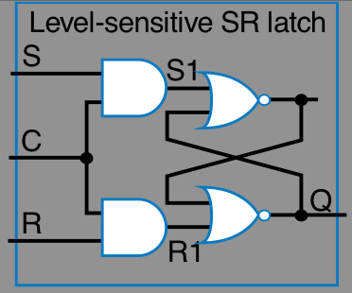
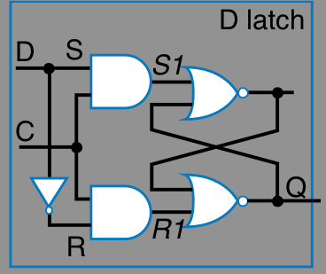
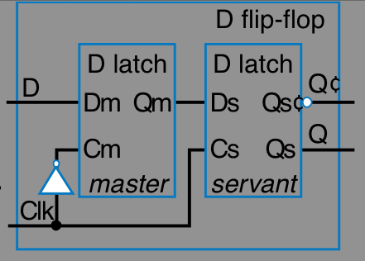
Latches
What advantage does a D-latch have over an SR latch and a level-sensitive SR latch?
 | SR Latch | Level-Sensitive SR Latch | D Latch | D Flip-Flop
Advantages | Set and reset functions OK | S and R only have effect when C = 1 | SR can’t be 11 | Only load value at rising clock edge
Disadvantages | Glitches may occur when S and R are 1 at the same time | Still hard to make sure S and R are not 1 at the same time | If we have D latches in series and C = 1 for too long, data will propagate through many latches | More gates required
Design

Slide 3
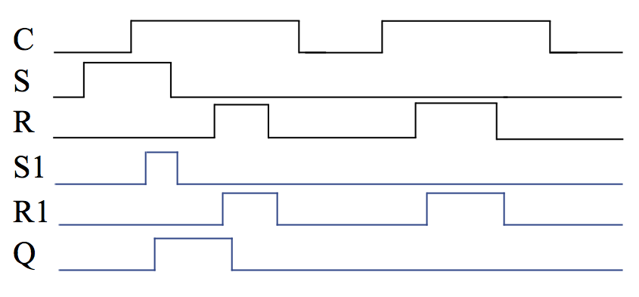
Latch Timing Diagram
Fill the following timing diagram assuming a level-sensitive SR latch is used

Slide 4
Latch Timing Diagram
Fill the following timing diagram assuming a level-sensitive SR latch is used

Slide 5
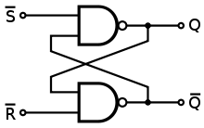
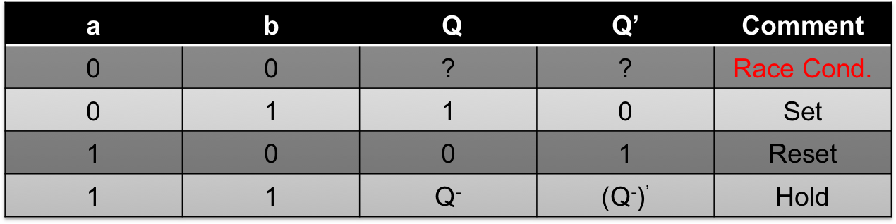
Latch Behavior
Fill in the truth table for the following latch design
  Assume old value of Q is Q⁻
a
a | b | (ab)’
0 | 0 | 1
0 | 1 | 1
1 | 0 | 1
1 | 1 | 0
b
Q’

Slide 6
Flip-Flops
What is a D flip-flop made of?
  2 D latches
D latch
0–>1
D latch
D1
D latch
D2
0–>1
D latch
0–>1
S1
0–>1
D2
S2
D1
S1
S2
0–>1
0–>1
0–>1
0–>1
C1
C2
Q2
C1
C2
Q2
Q1
R2
R2
R1
Q1
1–>0
0–>1
R1
0–>1
1–>0
1–>0
0–>1
0–>1
1–>0
Clk
Clk

Slide 7
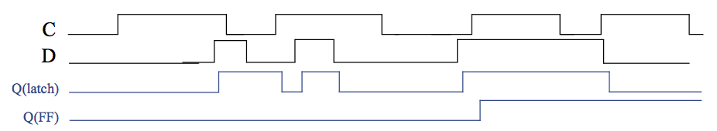
Flip-Flop Timing Diagram
Fill the following timing diagram
  As long as the C (clock) input is 1, the D latch will store the value of D (after a short gate delay)
  The D flip-flop will only store the value of D on the rising edge of C (after a short gate delay)

Slide 8
Synchronous / Asynchronous Control Inputs
Synchronous
  Changes are made at the rising edge of the clock
Asynchronous
  Changes are made as soon as possible
Two control inputs for the D flip-flop to
the right
  Reset (R)
  Set (S)
R
D
Q
’
S
Q

Slide 9
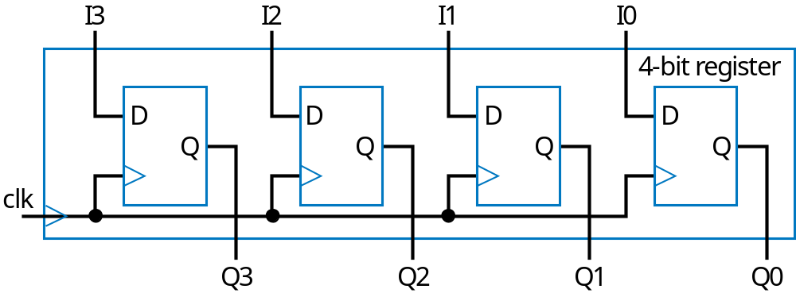
Registers
1-bit register is made of a flip-flop
For a 4-bit register, 4 flip-flops are needed

Slide 10
Registers
Which function supported by the following register have the highest priority?
  Shift right has the highest priority
  How would you design the corresponding circuit?
Shift | Load | Operation
0 | 0 | Hold
0 | 1 | Load parallel data
1 | X | Shift right

Slide 11
N-Bit Equality Comparator
Outputs 1 if two N-bit numbers are equal
  4-bit equality comparator with inputs A and B
    a3 must equal b3, a2 = b2, a1 = b1, a0 = b0
    F = (a3b3 + a3’b3’) * (a2b2 + a2’b2’) * (a1b1 + a1’b1’) * (a0b0 + a0’b0’)
    F = (a3 xnor b3) * (a2 xnor b2) * (a1 xnor b1) * (a0 xnor b0)
0110 = 0111 ?
a3
b3
a2
b2
a1
b1
a0
b0
0
0
1
1
1
1
0
1
1
1
1
0
a3
a2
a1
a0
b3
b2
b1
b0
4-bit equality comparator
=
eq
0
eq

Slide 12
Magnitude Comparator Design
Design a 4-bit magnitude comparator
a3
b3
a2
b2
a1
b1
a0
b0
a
b
a
b
a
b
a
b
Igt
in_gt
out_gt
in_gt
out_gt
in_gt
out_gt
in_gt
out_gt
AgtB
Ieq
in_eq
out_eq
in_eq
out_eq
in_eq
out_eq
in_eq
out_eq
AeqB
Ilt
in_lt
out_lt
in_lt
out_lt
in_lt
out_lt
in_lt
out_lt
AltB
Stage 3
Stage 2
Stage 1
Stage 0
How is each stage designed?

Slide 13
Magnitude Comparators
What happens next?
1
1
0
0
1
>
0
1
1
a3
b3
a2
b2
a1
b1
a0
b0
a
b
a
b
a
b
a
b
Igt
0
in_gt
out_gt
in_gt
out_gt
0
in_gt
out_gt
1
in_gt
out_gt
A
gtB
Ieq
1
in_eq
out_eq
in_eq
out_eq
1
in_eq
out_eq
0
in_eq
out_eq
A
eqB
I
lt
0
in_lt
out_lt
in_lt
out_lt
0
in_lt
out_lt
0
in_lt
out_lt
A
ltB
S
tage3
S
tage2
S
tage1
S
No comparison actually takes place since we already know that a > b.
What’s the delay of a comparator circuit?
tage0
1
1
0
0
1
0
1
1
a3
b3
a2
b2
a1
b1
a0
b0
a
b
a
b
a
b
a
b
Igt
0
in_gt
out_gt
in_gt
out_gt
in_gt
out_gt
1
in_gt
out_gt
1
A
gtB
Ieq
1
in_eq
out_eq
in_eq
out_eq
in_eq
out_eq
0
in_eq
out_eq
0
A
eqB
I
lt
0
in_lt
out_lt
in_lt
out_lt
in_lt
out_lt
0
in_lt
out_lt
0
A
ltB
S
tage3
S
tage2
S
tage1
S
tage0

Slide 14
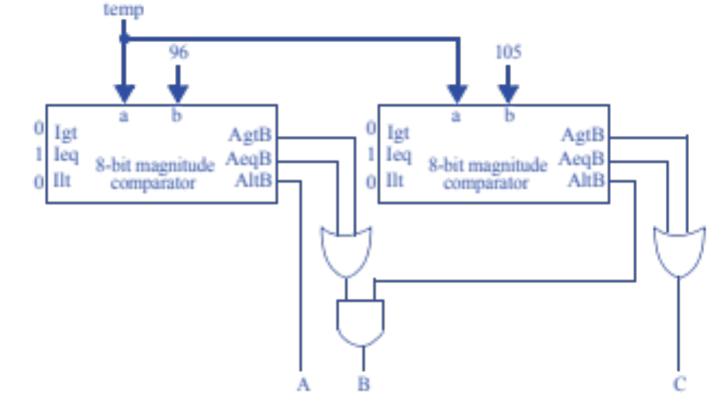
Design I
Design a human body temperature indicator system for a hospital bed. Your system takes an 8-bit input representing the temperature, which can range from 0 to 255. If the measured temperature is 95 or less, set output A to 1. If the temperature is 96 to 104, set output B to 1. If the temperature is 105 or above, set output C to 1.

Slide 15
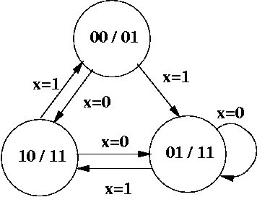
Finite State Machines
Why is the following FSM not safe?
  In a safe FSM, the total number of states is a power of 2
…

Slide 16
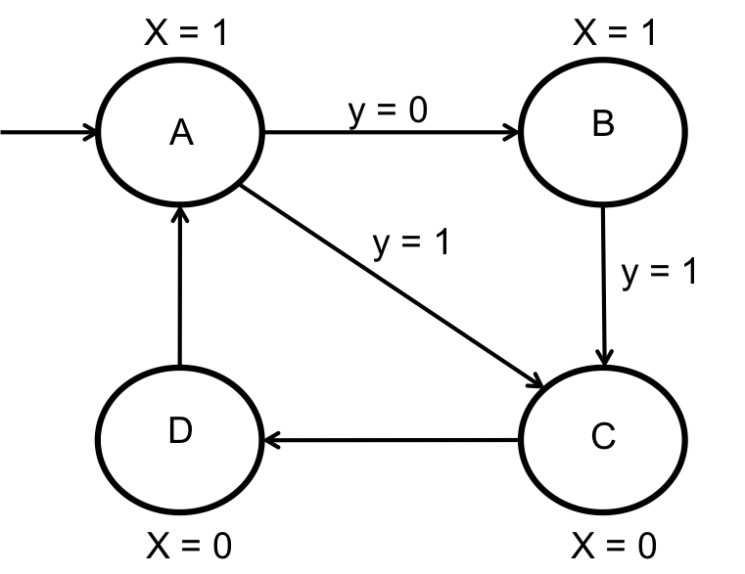
Finite State Machines
What’s wrong with the following FSM?
  It has incomplete transitions
    What if y = 0 while in state B?

Slide 17
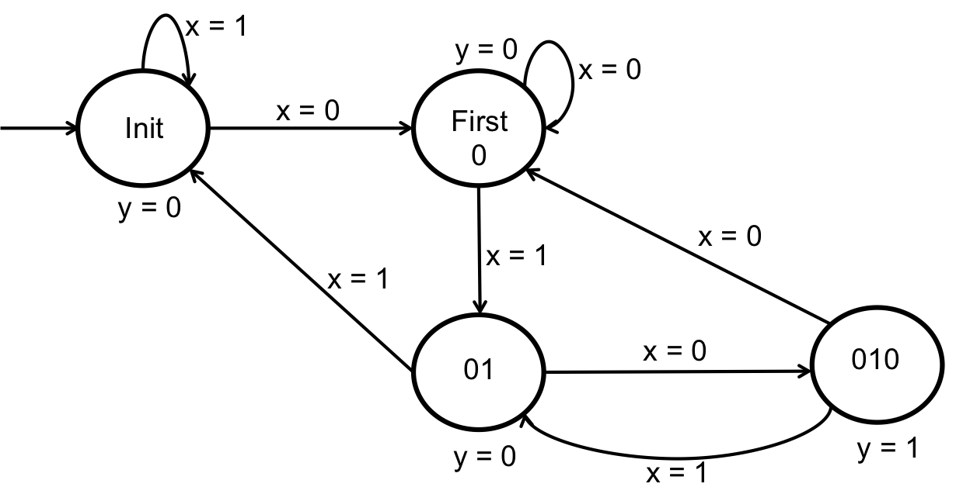
FSM Design
Create an FSM that sets the output y to 1 if a sequence of 010 has been detected. The system has a 1-bit input x, which can be either 0 or 1.
Can you convert this FSM to circuit?

Slide 18
Adders
Consider two unsigned numbers A = 01100100 and B = 10010110. What is S = A + B?
  A = 01100100
  B = 10010110
  S = A + B = 11111010

Slide 19
Adders
Consider a 64-bit carry-ripple adder built with only FAs. If the delay of an FA is 3ns, what is the delay of the carry-ripple adder?
  64 x 3 = 192ns

Slide 20
Incrementors
Let’s consider two 4-bit incrementor designs
  Incrementor designed using full adders
  Incrementor designed using half adders
If the delay for a full adder is twice that of a half adder, how much faster is the second design compared to the first one?
  Twice as fast

Slide 21
Multipliers & Dividers
Express the following in terms of shift operations
  F = A / 16
  F = A / 16 = A >> 4

Slide 22
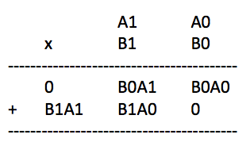
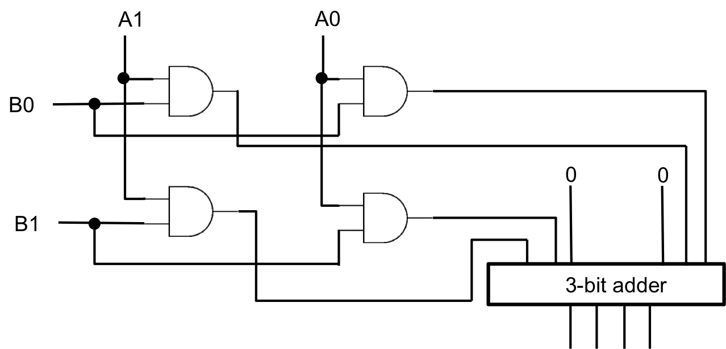
Multiplier Design
Given two 2-bit inputs A and B, design a 2x2 multiplier
  How wide is the output?

Slide 23
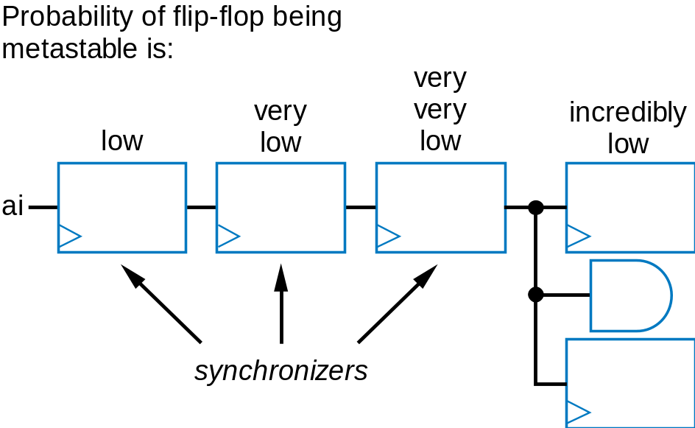
Glitch? Metastability? Race Condition?
Glitch: unintended behavior due to inputs
  May be due to violation in flip-flop setup or hold time
Metastability: caused by glitch
  State is not 0 nor 1
    Will eventually settle on a value, but we don’t know which → race condition
  Minimize occurrence
  of metastability
  using synchronizer
  flip-flops
Output glitches can
also occur
  Use registered outputs

Slide 24
Registered Output
What is registered output, how can it be used, and what is its potential side effect?
  Registered output can be used to avoid output glitches
  It increases the delay of the circuit by one clock cycle
b
x
D
xr
Combinational
n1
flip-flop
logic
n0
s1
s0
State register

